Slide 1
Programming assignment Report
Bhupathi Reddy B

Slide 2
Task 1: object detection
OVERVIEW:
We have to detect various elements that are present in the memes.
Catalog various elements that are detected.
Pretrained model yolo v8 has been used.
Yolo v8 has not been trained on our custom dataset, pre-trained weights have been used to detect the objects.
Yolo v8 contained 80 classes of various categories like food, transport, etc.

Slide 3
METHODOLOGIES:
The easiest method is to use pre-trained models and do object detection for the pre-defined classes.
The dataset contained more elements like Muslims, specific animals, Asians, black people. A custom built model for these majority classes would have been much better than a pre-trained model.
As the dataset was huge, I used the distribution of the objects to create a sample dataset which could be used for the other tasks.

Slide 4
ISSUES FACED:
Lack of computation power because of which object detection took lot of time.
The pre-defined classes were not enough to capture the total distribution of the dataset.
The dataset was not annotated due to which building a custom object detection model was not feasible.
The captions were a hindrance for the detection of objects.

Slide 5
IMPROVEMENTS:
If object detection was performed after removing the captions, the result would have been better.
If a group/team is available, they can annotate the dataset to build a custom object detection model which will be far accurate in detecting the elements.

Slide 6


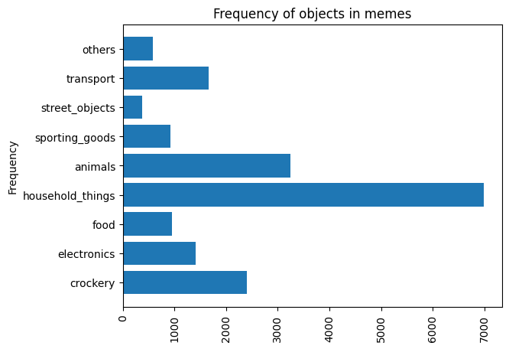
RESULTS & FINDINGS:
As expected the most frequent element in the memes was 'humans'.
If daily objects are kept aside, animals and crockery have taken the next ranks.
Many of the memes contained Muslims, Americans, Hitler, Asians, Black people, goats, etc.

Slide 7
Task 2: Caption impact assessment
OVERVIEW:
Assess the impact of caption on object detection.
Use image processing techniques to remove the caption from the images.
Reconstruction of images after the caption is removed.

Slide 8
METHODOLOGIES:
To assess the impact of the captions on the object detection, the captions have been removed using functions from the module keras_ocr.
The confidence levels of predictions in the processed and original memes have been compared to analyze the impact.
The change in object detections, before and after the processing have been also compared to understand the impact of captions better.

Slide 9
ISSUES FACED:
The quality of the image reconstruction after the captions have been removed was not good as expected.
Due to which the object detections after the processing was also affected.
The confidence levels of predictions dropped in the processed images.

Slide 10
IMPROVEMENTS:
A better image processing technique to remove the captions will help us understand the caption impact better.
Detections around the captions could be avoided to reduce wrong detections.

Slide 11
RESULT:
The negative confidence levels increased compared to the positive confidence level in the object detections after processing.
The number of objects detected in many processed images has gone down compared to their original images, this is an indication that there have been many misclassifications due to the captions.
No images had new detections which had 0 objects in them even after processing.

Slide 12
Task 3: classification system development
OVERVIEW:
Develop a classification system based on something non-trivial.
I chose to develop a classification system which could predict whether a given image is meme or not.
Data for the positive set class was provided, had to collect for the other class.

Slide 13
METHODOLOGIES:
There are two ways in which we can build this model:
Build a simple CNN classifier fed with the memes and non-memes directly.
The other approach is to extract features the caption and the images separately and combine them to form a single vector which would capture more meaning.
But every non-meme image may not contain captions.

Slide 14
ISSUES FACED:
No datasets or repositories could be found, due to which enough data could not be collected.
Manually collecting non-memes was very tough, I could only muster around 250 images.
Could not build a model due to very low non-meme images, the model would only overfit to the data.

Slide 15
Task 4: Bonus task
OVERVIEW:
Find out whether the caption of a meme is toxic or not.
Toxicity may not only depend on the caption of the meme, but may depend on the image as well.
Merge these two elements to assess the toxicity of the memes.

Slide 16
METHODOLOGIES:
Build a classifier based on the sentiment of the caption.
The classifier is to be built on text which is toxic, so that it could be used to assess the toxicity of our memes.
Trained a Naïve Bayes model on a dataset found on Kaggle.
Simple approach is to build the above classifier and the better one is to build a model which would combine both the elements of caption and the image.

Slide 17
ISSUES FACED:
The model was built on a dataset containing comments from social media posts, where the captions in the memes are different. The distribution of data is not the same.
Faced issues in vectorization of text as the model was built on large text and the captions are small.
Wanted to build a feature vector which combined the visual and the linguistic features but I have no knowledge of how to do it.

Slide 18
RESULT:
The captions were not enough to assess the toxicity of the memes.
No toxic memes were detected using a model which was built on toxic comments.

Slide 19
References:
https://www.freecodecamp.org/news/how-to-detect-objects-in-images-using-yolov8/
https://github.com/bnsreenu/python_for_microscopists
https://valueml.com/meme-classification-using-cnn-in-python/
https://www.kaggle.com/competitions/jigsaw-toxic-comment-classification-challenge

Slide 20
Thank you

